Slide 1
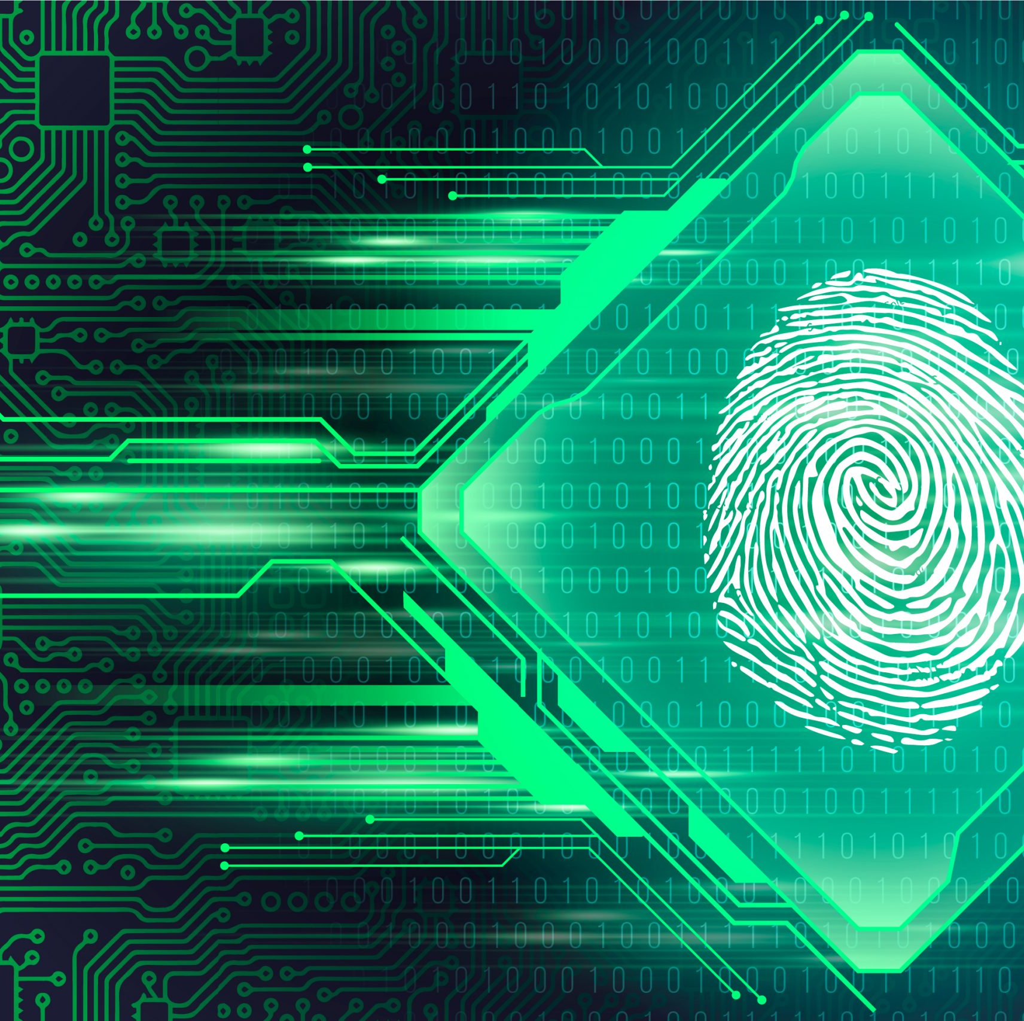
Biometric Template
Protection
Using
Fuzzy Vault
~ Sagnik Chakraborty

Slide 2
Presentation Flow
Need for Biometric Security
Common Attacks on Biometric Templates
Fuzzy Vault
Operations of a Fuzzy Vault Scheme
Fuzzy Vault Implementation
Vault Encoding
Vault Decoding
Fingerprint Alignment based on Helper Data
Iterative Closet Algorithm
Security of Fuzzy Vault
Biometric Template Security using Palm Print Features
Steps Involved in Vault Encoding of Palm Print

Slide 3
Need for Biometric Security
Personal Identity refers to a set of attributes that are associated with a person.
Identity Management is the process of maintaining the identities of individuals.
Establishing a person's identity is called person recognition or authentication and is a critical task in any identity management system.
A reliable identity management system is an urgent need to combat the epidemic growth of identity theft and to meet the increased security requirements in various applications.
Passwords and keys were once considered sufficient to provide data security, but now they look increasingly feeble in the presence of sophisticated hacker attacks. A robust authentication method is a need in today’s time.
This has put the focus on biometric systems as the only effective way to prove an individual’s identity in cryptosystems.
Biometric traits are inherent and unique to each individual and can verify an individual’s identity with utmost accuracy and reliability.

Slide 4
Common Attacks on Biometric Templates
Due to rapid growth in sensing and computing technologies, biometric systems have become easily affordable and are easily embedded in a variety of consumer devices, making them vulnerable to the malicious designs of terrorists and criminals.
A critical issue in biometric systems is to secure the template of a user which is typically stored in a database or a smart card.
Biometric templates are vulnerable to a variety of attacks due to their inherent nature aimed at compromising the security of biometric templates. Some of the common attacks attempted on biometric templates are:
Impersonation Attack: An adversary tries to present a biometric sample that mimics the original biometric characteristics of the authorized user. For example: An attacker can use a high-quality fake fingerprint to bypass a fingerprint authentication system.
Replay Attack: An adversary captures the biometric data of an authorized user during a successful authentication process and then replays the same data to the biometric system to gain unauthorized access.

Slide 5
Template Attack: Using side-channel attacks, observation attacks, phishing attacks attackers can steal or intercept biometric template of an authorized user and then using it to spoof the biometric system.
Morphing Attack: An attacker tries to combine two or more biometric templates to create a new template that matches with both the original templates.
Brute Force Attack: An attacker attempts every possible combination of biometric features until the correct match is found.
Man-in-the-Middle Attack: An adversary intercepts the communication between the biometric system and the user and alters the biometric data exchanged between them.
Trojan Horse Attack: An adversary infects the biometric system with malicious software that alters the operations of the system to gain unauthorized access or steal biometric data.
When a person’s biometric features are compromised, his identity is lost, In contrast to password Biometric identity is not revocable. So providing security to the stored biometric template is very crucial.
Notes:
Morphing: An attacker can create a fake face image by morphing the features of two or more faces to bypass a face recognition system.
Man-in-the-Middle: This can be used to compromise the integrity and confidentiality of the biometric authentication process.

Slide 6
Fuzzy Vault
Juels and Sudan proposed a cryptographic construction called a fuzzy vault that operates in the key binding mode where the key and the template are monolithically bound within a cryptographic framework and, can compensate for intraclass variations in the biometric data.
It is computationally infeasible to decode the key or the template without any knowledge of the user’s biometric data.
So to use it in Biometric Template protection the abstract way is:
Alice authenticates to her server using fingerprint information. The system admin will store her fingerprint on the server , more precisely, a set M of features characterizing her fingerprint aka templates. When Alice tries to authenticate herself, her fingerprint reader is likely to produce a template M’ that is similar to, but not identical to M.
Alice will store a KEY locked in a fuzzy vault on a set M of features describing her fingerprint and achieve error tolerance and privacy.
Since Biometric Features are prone to the problem of erasures, order-invariance is critical here.
Notes:
Let us consider a scenario that will help us build the idea of Fuzzy Vault.
Alice is a movie lover. She is looking to find someone who shares her taste in movies, but does not want to reveal information about her preferences indiscriminately to other people. One approach she might take is to compile a set A of her favourite movies encrypt her contact number C as Enc(A,C)=ciphertext ‘ct’ where A is the Key and then publish it. In this case if another person, say Bob, comes along with a set B of his own favourites that is identical to A, then he can decrypt ct and obtain Alice’s contact number. If Bob tries to decrypt ct with a set different than Alice’s, he will fail to obtain her contact number. A drawback to to this approach is its exactitude, or lack of error-tolerance. If Bob’s interests are very similar to Alics’s e.g., if he like two or three films that Alice doesn’t then he will not learn contact number of Alice. It seems very likely in this case, though, that Alice would still like Bob to obtain her telephone number, as their tastes are quite similar.
A solution to this case would be to have a cryptographic construction whereby Alice can lock her contact number using the set A yielding a vault V. If Bob tries to unlock the vault V using his own set B, he will succed provided that B overlaps largely with A. On the other hand, anyone who tries to unlock V with a set of favourite movies differing substantially from Alice’s will fail,helping to ensure hat Alics’s set of favourite’s remain private. Here two important features are: set A and set B may be arbitrarily ordered. We are able to prove information-thoritic security bounds over some natural non-uniform distributions on set A

Slide 7
Operation of a Fuzzy Vault Scheme
Suppose that a user wishes to hide a secret K (e.g., a cryptographic key) using his or her biometric sample (template) which is represented as an unordered set (e.g., minutiae in fingerprints) X.
The user selects a polynomial P that encodes the secret K and evaluates the polynomial on all elements in X.
The user then chooses a large number of random chaff points which do not lie on the polynomial P. The entire collection of points consisting of both points lying on P and those that do not lie on P constitute the vault V.
These chaff points conceal the genuine points lying on P. It ensures both the template and secret simultaneously.
The user can retrieve the secret K from the vault V by providing another biometric sample(query) which is also represented as another unordered set X’.
If a sufficient number of points can be identified, an error correction scheme can be applied to exactly reconstruct P and thereby decode the secret K.

Slide 8
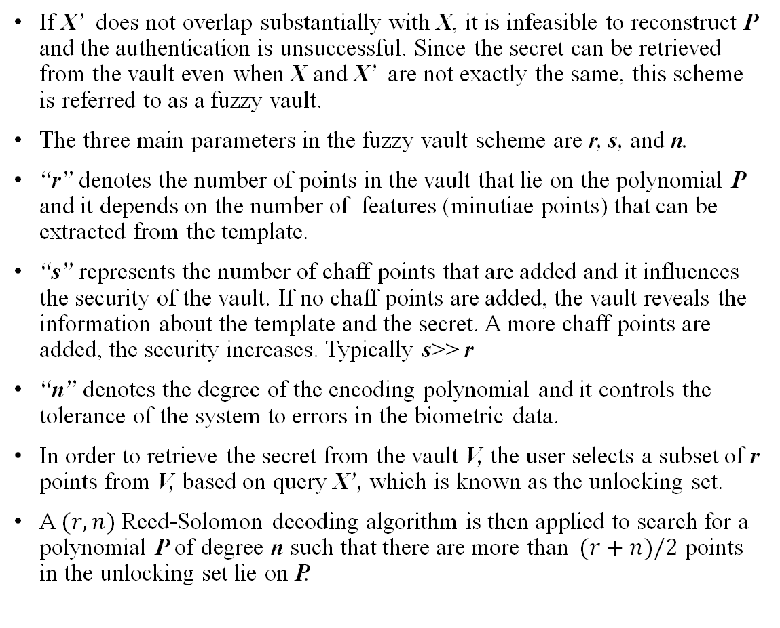
If X’ does not overlap substantially with X, it is infeasible to reconstruct P and the authentication is unsuccessful. Since the secret can be retrieved from the vault even when X and X’ are not exactly the same, this scheme is referred to as a fuzzy vault.
The three main parameters in the fuzzy vault scheme are r, s, and n.
“r” denotes the number of points in the vault that lie on the polynomial P and it depends on the number of features (minutiae points) that can be extracted from the template.
“s” represents the number of chaff points that are added and it influences the security of the vault. If no chaff points are added, the vault reveals the information about the template and the secret. A more chaff points are added, the security increases. Typically s˃˃ r
“n” denotes the degree of the encoding polynomial and it controls the tolerance of the system to errors in the biometric data.
In order to retrieve the secret from the vault V, the user selects a subset of r points from V, based on query X’, which is known as the unlocking set.
A $(r,n)$Reed-Solomon decoding algorithm is then applied to search for a polynomial P of degree n such that there are more than $(r+n)/2$ points in the unlocking set lie on P.
Operation of a Fuzzy Vault Scheme​

Slide 9
The security of this scheme is based on the infeasibility of the polynomial reconstruction problem (i.e., if in the query image, we are not able to locate many points which lie on P, then we cannot feasibly find the parameters of P, hence cannot access K) which is a special case of Reed-Solomon list decoding problem.
The scheme can tolerate some differences between the entities (X & X’) that lock and unlocks the vault, so Juels and Sudan named their scheme fuzzy vault.
This fuzziness can come from the variability of biometric data; even though the same biometric entity is analyzed during different acquisitions, the extracted biometric data will vary due to acquisition characteristics, sensor noise, etc.
Notes:
The polynomial reconstruction problem is considered infeasible when it is computationally difficult to reconstruct the original polynomial function that was used to generate a set of points.
If an attacker is able to reconstruct the original polynomial function, they would be able to determine the user’s secret key and gain access to the system.
However, reconstructing the polynomial requires solving a system of linear equations, which becomes increasingly difficult as the degree of the polynomial and the number of points used in the system increase.

Slide 10
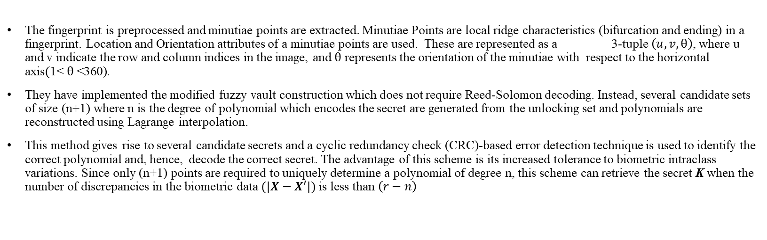
Fuzzy Vault Implementation
The fingerprint is preprocessed and minutiae points are extracted. Minutiae Points are local ridge characteristics (bifurcation and ending) in a fingerprint. Location and Orientation attributes of a minutiae points are used. These are represented as a 3-tuple $\left(u,v,θ\right)$, where u and v indicate the row and column indices in the image, and $θ$ represents the orientation of the minutiae with respect to the horizontal axis$(\text{1≤} θ \text{≤360}\text{)}$.
They have implemented the modified fuzzy vault construction which does not require Reed-Solomon decoding. Instead, several candidate sets of size (n+1) where n is the degree of polynomial which encodes the secret are generated from the unlocking set and polynomials are reconstructed using Lagrange interpolation.
This method gives rise to several candidate secrets and a cyclic redundancy check (CRC)-based error detection technique is used to identify the correct polynomial and, hence, decode the correct secret. The advantage of this scheme is its increased tolerance to biometric intraclass variations. Since only (n+1) points are required to uniquely determine a polynomial of degree n, this scheme can retrieve the secret K when the number of discrepancies in the biometric data $(|X−X′|)$ is less than $\left(r−n\right)$
Notes:
If the number of discrepancies in the biometric data are less than $(r−n)/2$ a valid polynomial P can be found and the secret K can be successfully retrieved
The Lagrange interpolation formula is a way to find a polynomial which takes on certain values at arbitrary points.
Given n distinct real values x1,x2,…xn and n real values y1,y2,…,yn (not necessarily distinct), there is a unique polynomial P with real coefficients satisfying P(xi)=yi for i belongs to{1,2,..,n}, such that deg(P)<n.
Suppose we have sequence of points: (1,3),(2,4) We find a polynomial that represent it as follows P(1)=3 , P(2)=4
So P(x)=$\frac{x−2}{1−2}∗3+\frac{x−1}{2−1}∗4$

Slide 11
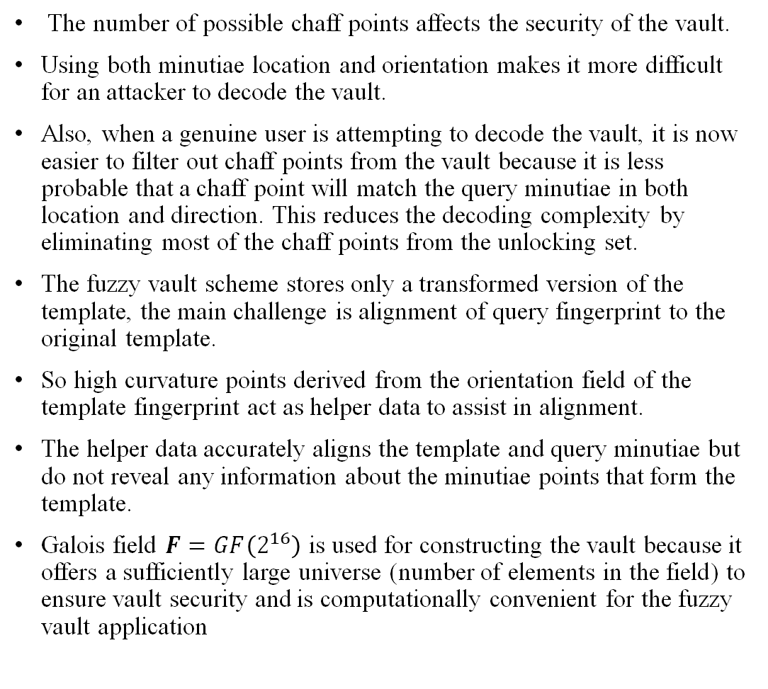
The number of possible chaff points affects the security of the vault.
Using both minutiae location and orientation makes it more difficult for an attacker to decode the vault.
Also, when a genuine user is attempting to decode the vault, it is now easier to filter out chaff points from the vault because it is less probable that a chaff point will match the query minutiae in both location and direction. This reduces the decoding complexity by eliminating most of the chaff points from the unlocking set.
The fuzzy vault scheme stores only a transformed version of the template, the main challenge is alignment of query fingerprint to the original template.
So high curvature points derived from the orientation field of the template fingerprint act as helper data to assist in alignment.
The helper data accurately aligns the template and query minutiae but do not reveal any information about the minutiae points that form the template.
Galois field $F=GF\left(2^{16}\right)$ is used for constructing the vault because it offers a sufficiently large universe (number of elements in the field) to ensure vault security and is computationally convenient for the fuzzy vault application

Slide 12

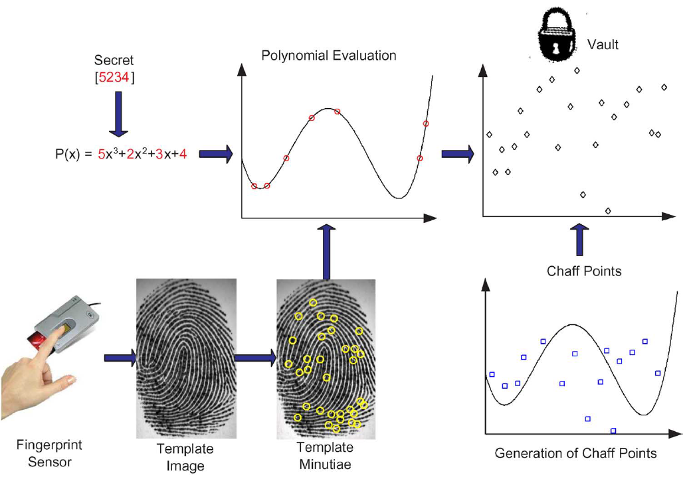
Vault Encoding

Slide 13
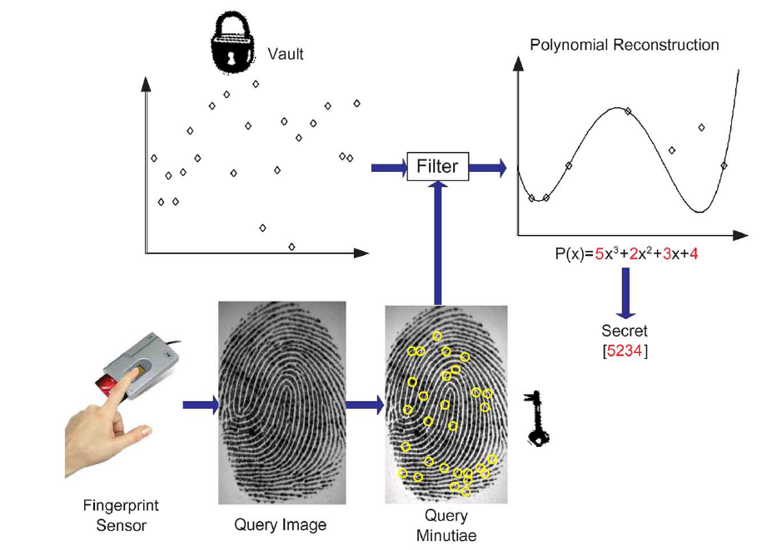
Vault Decoding

Slide 14
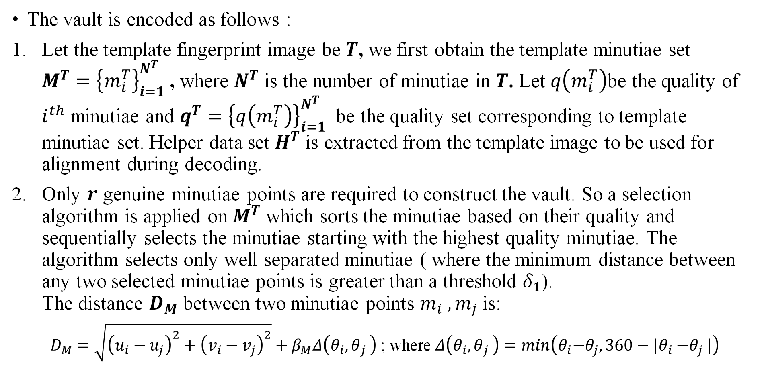
Vault Encoding
The vault is encoded as follows :
Let the template fingerprint image be $T$, we first obtain the template minutiae set $M^{T}={\left\{m_{i}^{T}\right\}}_{i=1}^{N^{T}}$ , where $N^{T}$ is the number of minutiae in $T$. Let $q\left(m_{i}^{T}\right)$be the quality of $i^{th}$ minutiae and $q^{T}={\left\{q\left(m_{i}^{T}\right)\right\}}_{i=1}^{N^{T}}$ be the quality set corresponding to template minutiae set. Helper data set $H^{T}$ is extracted from the template image to be used for alignment during decoding.
Only $r$ genuine minutiae points are required to construct the vault. So a selection algorithm is applied on $M^{T}$ which sorts the minutiae based on their quality and sequentially selects the minutiae starting with the highest quality minutiae. The algorithm selects only well separated minutiae ( where the minimum distance between any two selected minutiae points is greater than a threshold $δ_{1}$). The distance $D_{M}$ between two minutiae points $m_{i} ,m_{j}$ is:
$D_{M}=\sqrt{{\left(u_{i}−u_{j}\right)}^{2}+{\left(v_{i}−v_{j}\right)}^{2}}+β_{M}Δ\left(θ_{i}{,θ}_{j}\right)$ ; where $Δ\left(θ_{i}{,θ}_{j}\right)=min\left(θ_{i}{−θ}_{j},360−|θ_{i}{−θ}_{j}|\right)$
Notes:
Delta1:0.8mm to 1mm
Local quality index :
LQI is a measure of the quality of individual fingerprint regions.
The region of interest is first divided into a grid of subregions, with each subregion being of size $m×m$ pixels.
A set of image features is then extracted from each subregion, including ridge density, orientation coherence, contrast, and regularity. These features are designed to capture the texture and structural properties of the fingerprint in the subregion.
The feature values for each subregion are normalized to a range between 0 and 1
A weighted average of the feature values is then computed for the subregions within the region of interest (ROI).
The LQI is computed as the product of the weighted average feature values for the subregions within region of interest.
The resulting LQI provides a quantitative measure of the the fingerprint region.
$β_{M}$ are the weights assigned to the orientation attribute (0.2 because variation in orientation attribute of minutiae is usually much larger compared to the variation in its location attribute so lesser weight is assigned to it.)
The selection of well-separated minutiae ensures that they are assigned unique values when they are encoded into the field $F$ .

Slide 15
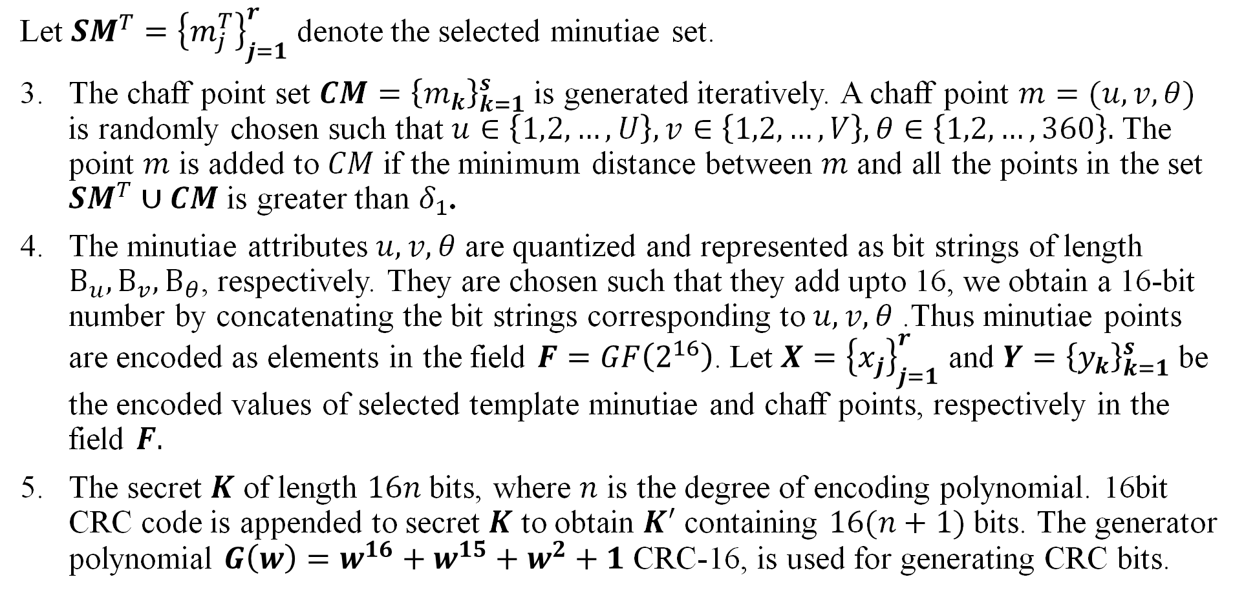
Vault Encoding
Let ${SM}^{T}={\left\{m_{j}^{T}\right\}}_{j=1}^{r}$ denote the selected minutiae set.
The chaff point set $CM={\left\{m_{k}\right\}}_{k=1}^{s}$ is generated iteratively. A chaff point $m=(u,v,θ)$ is randomly chosen such that $u∈\left\{1,2,…,U\right\}, v∈\left\{1,2,…,V\right\},θ∈\left\{1,2,…,360\right\}.$ The point $m$ is added to $CM$ if the minimum distance between $m$ and all the points in the set ${SM}^{T}∪CM$ is greater than $δ_{1}$.
The minutiae attributes $u,v,θ$ are quantized and represented as bit strings of length $Β_{u},Β_{v},Β_{θ}$, respectively. They are chosen such that they add upto 16, we obtain a 16-bit number by concatenating the bit strings corresponding to $u,v,θ$ .Thus minutiae points are encoded as elements in the field $F=GF\left(2^{16}\right)$. Let $X={\left\{x_{j}\right\}}_{j=1}^{r}$ and $Y={\left\{y_{k}\right\}}_{k=1}^{s}$ be the encoded values of selected template minutiae and chaff points, respectively in the field $F.$
The secret $K$ of length $16n$ bits, where $n$ is the degree of encoding polynomial. 16bit CRC code is appended to secret $K$ to obtain $K′$ containing $16(n+1)$ bits. The generator polynomial $G\left(w\right)=w^{16}+w^{15}+w^{2}+1$ CRC-16, is used for generating CRC bits.
Notes:
If the number of minutiae points in $T$ is less than $r$ or if the selection algorithm fails to find $r$well-separated minutiae, we consider it as a failure-to-capture (FTC) error and no further processing takes place
CRC is a simple and efficient method for detecting errors in data.
The specific steps involved in calculating the CRC checksum for a given block of data are as follows:
1)The data block is first treated as a binary polynomial, with the coefficient of each bit corresponding to its binary value (0 or 1).
2)The most significant bit is assigned the highest coefficient value.
3)A generator polynomial is chosen, typically with a degree that is one less than the length of the checksum.
4)The generator polynomial is typically fixed and agreed upon in advance by the transmitter and receiver.
5)The polynomial for the data block is divided by the generator polynomial using binary division with no carry. The remainder of this division operation is the CRC checksum.

Slide 16
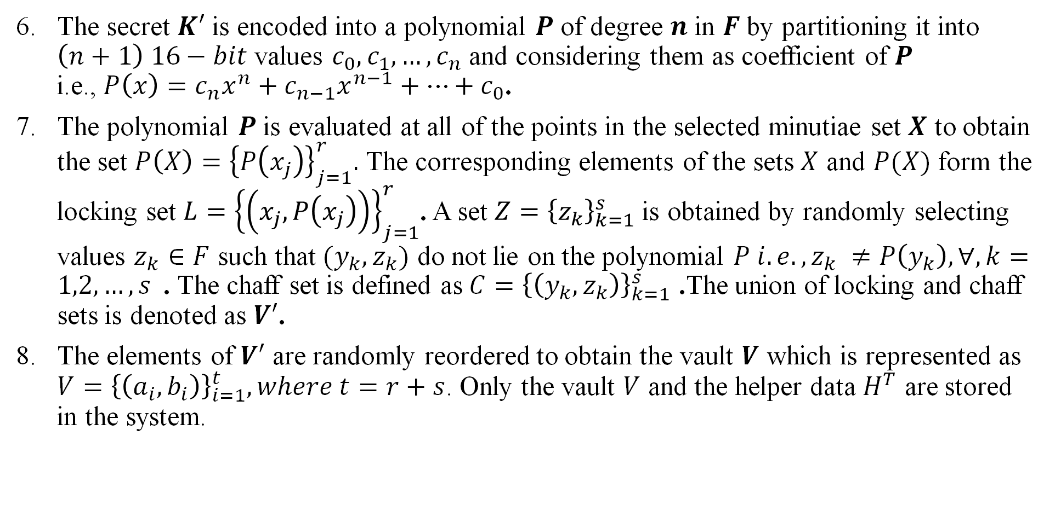
Vault Encoding
The secret $K′$ is encoded into a polynomial $P$ of degree $n$ in $F$ by partitioning it into $\left(n+1\right) 16−bit$ values $c_{0},c_{1},…,c_{n}$ and considering them as coefficient of $P$ i.e.,$P\left(x\right)=c_{n}x^{n}+c_{n−1}x^{n−1}+…+c_{0}$.
The polynomial $P$ is evaluated at all of the points in the selected minutiae set $X$ to obtain the set $P\left(X\right)={\left\{P\left(x_{j}\right)\right\}}_{j=1}^{r}.$ The corresponding elements of the sets $X$ and $P(X)$ form the locking set $L={\left\{\left(x_{j},P\left(x_{j}\right)\right)\right\}}_{j=1}^{r}$. A set $Z={\left\{z_{k}\right\}}_{k=1}^{s}$ is obtained by randomly selecting values $z_{k}∈F$ such that $(y_{k},z_{k})$ do not lie on the polynomial $P i.e., z_{k} ≠P\left(y_{k}\right),∀,k=1,2,…,s$. The chaff set is defined as$C={\left\{\left(y_{k},z_{k}\right)\right\}}_{k=1}^{s}$ .The union of locking and chaff sets is denoted as $V′$.
The elements of $V′$ are randomly reordered to obtain the vault $V$ which is represented as $V={\left\{\left(a_{i},b_{i}\right)\right\}}_{i=1}^{t}, where t=r+s$. Only the vault $V$ and the helper data $H^{T}$ are stored in the system.

Slide 17
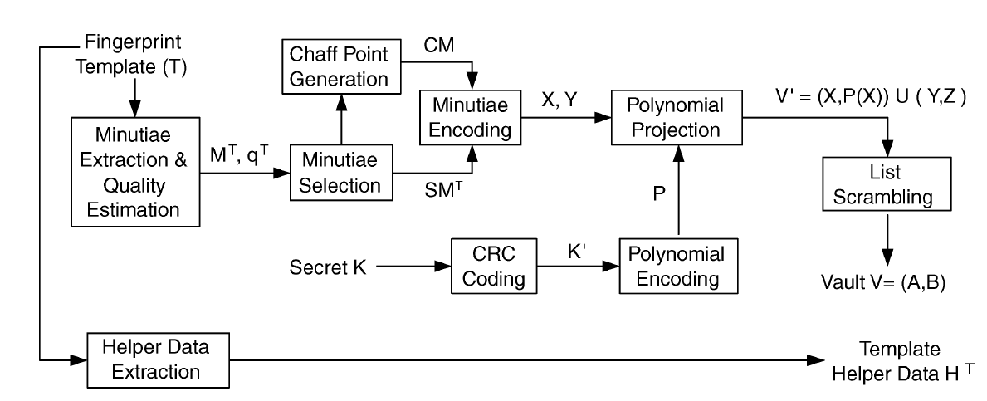
VAULT ENCODING

Slide 18
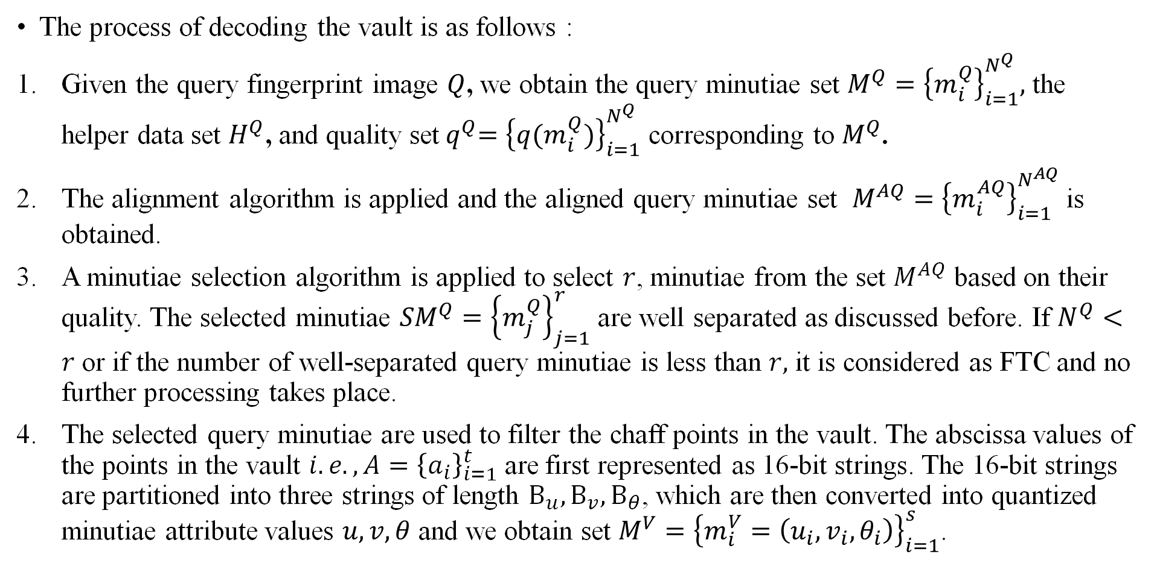
Vault Decoding
The process of decoding the vault is as follows :
Given the query fingerprint image $Q$, we obtain the query minutiae set $M^{Q}={\left\{m_{i}^{Q}\right\}}_{i=1}^{N^{Q}},$ the helper data set $H^{Q}$, and quality set${ q}^{Q}={\left\{q(m_{i}^{Q})\right\}}_{i=1}^{N^{Q}}$ corresponding to $M^{Q}$.
The alignment algorithm is applied and the aligned query minutiae set $M^{AQ}={\left\{m_{i}^{AQ}\right\}}_{i=1}^{N^{AQ}}$ is obtained.
A minutiae selection algorithm is applied to select $r$, minutiae from the set $M^{AQ}$ based on their quality. The selected minutiae ${SM}^{Q}={\left\{m_{j}^{Q}\right\}}_{j=1}^{r}$ are well separated as discussed before. If $N^{Q}<r$ or if the number of well-separated query minutiae is less than $r,$ it is considered as FTC and no further processing takes place.
The selected query minutiae are used to filter the chaff points in the vault. The abscissa values of the points in the vault $i.e., A={\left\{a_{i}\right\}}_{i=1}^{t}$ are first represented as 16-bit strings. The 16-bit strings are partitioned into three strings of length $Β_{u},Β_{v},Β_{θ}$, which are then converted into quantized minutiae attribute values $u,v,θ$ and we obtain set $M^{V}={\left\{m_{i}^{V}=\left(u_{i},v_{i},θ_{i}\right)\right\}}_{i=1}^{s}$.

Slide 19
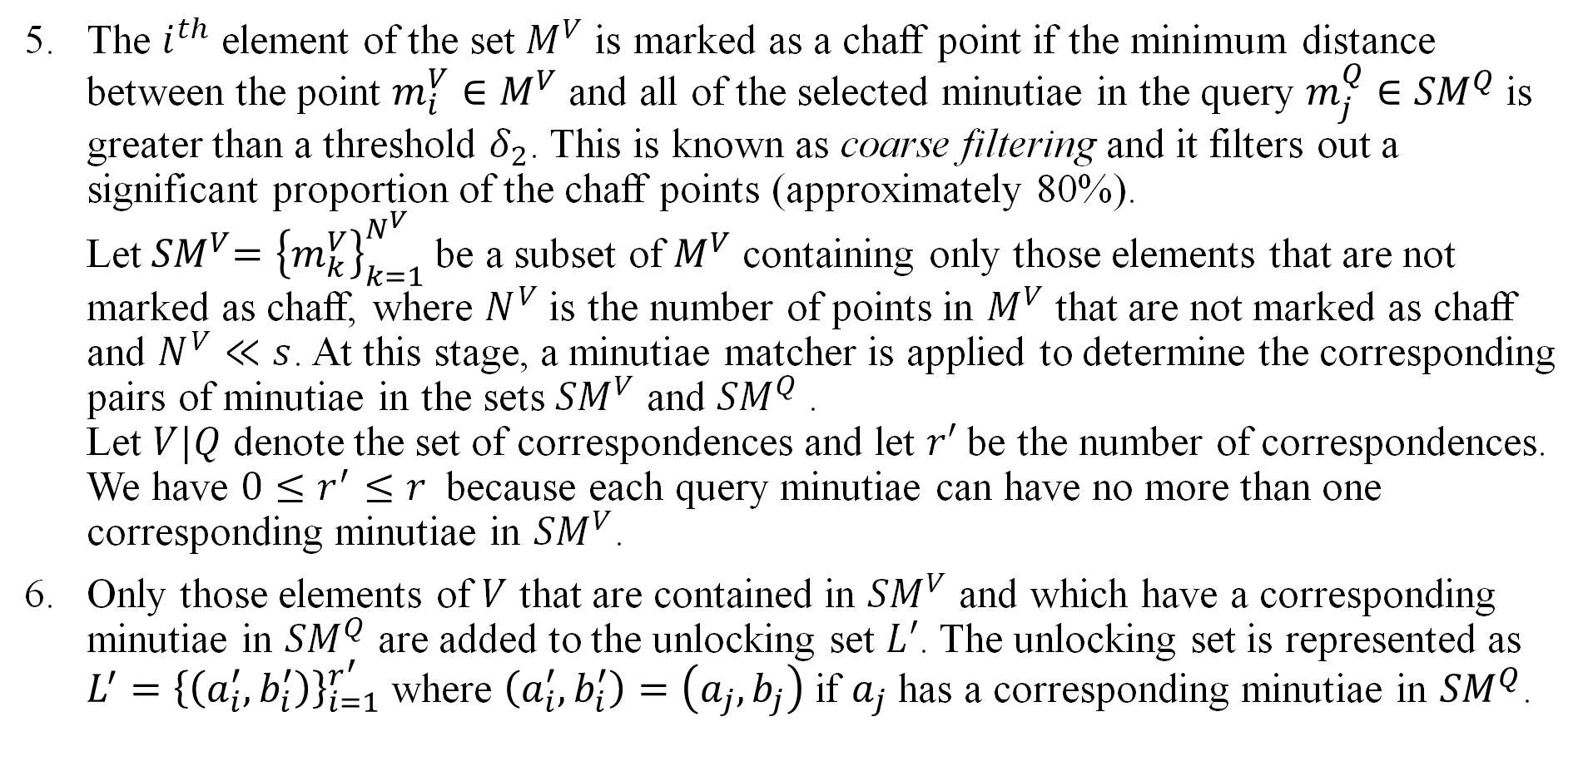
Vault Decoding
The $i^{th}$ element of the set $M^{V}$ is marked as a chaff point if the minimum distance between the point $m_{i}^{V}∈M^{V}$ and all of the selected minutiae in the query $m_{j}^{Q}∈{SM}^{Q}$ is greater than a threshold $δ_{2}$. This is known as coarse filtering and it filters out a significant proportion of the chaff points (approximately 80%). Let${ SM}^{V}={\left\{m_{k}^{V}\right\}}_{k=1}^{N^{V}}$ be a subset of $M^{V}$ containing only those elements that are not marked as chaff, where $N^{V}$ is the number of points in $M^{V}$ that are not marked as chaff and $N^{V}≪s$. At this stage, a minutiae matcher is applied to determine the corresponding pairs of minutiae in the sets ${SM}^{V}$ and ${SM}^{Q}$. Let $V|Q$ denote the set of correspondences and let $r′$ be the number of correspondences. We have $0≤r^{′}≤r$ because each query minutiae can have no more than one corresponding minutiae in ${SM}^{V}$.
Only those elements of $V$ that are contained in ${SM}^{V}$ and which have a corresponding minutiae in ${SM}^{Q}$ are added to the unlocking set $L′$. The unlocking set is represented as $L^{′}={\left\{\left(a_{i}^{′},b_{i}^{′}\right)\right\}}_{i=1}^{r^{′}}$ where $\left(a_{i}^{′},b_{i}^{′}\right)=\left(a_{j},b_{j}\right)$ if $a_{j}$ has a corresponding minutiae in ${SM}^{Q}$.
Notes:
How does minutiae matcher works: As discussed in class flags and distance rot hough transform
It is also possible to directly apply the minutiae matcher to find correspondences between $M^{V}$ and ${SM}^{Q}$ without any coarse filtering but it is not effective since there are large number of chaff points in the vault which can lead to false correspondences. Hence coarse filter step is essential before the minutiae matcher is applied.

Slide 20
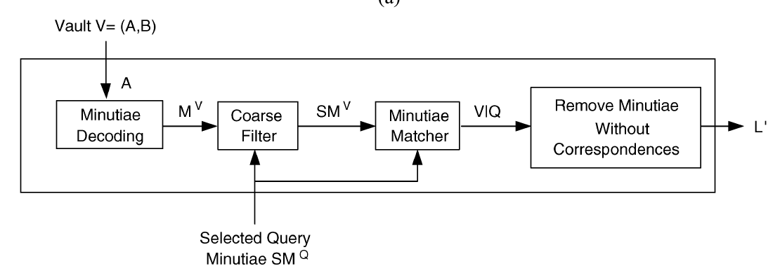
Details of the filter used to eliminate chaff points

Slide 21
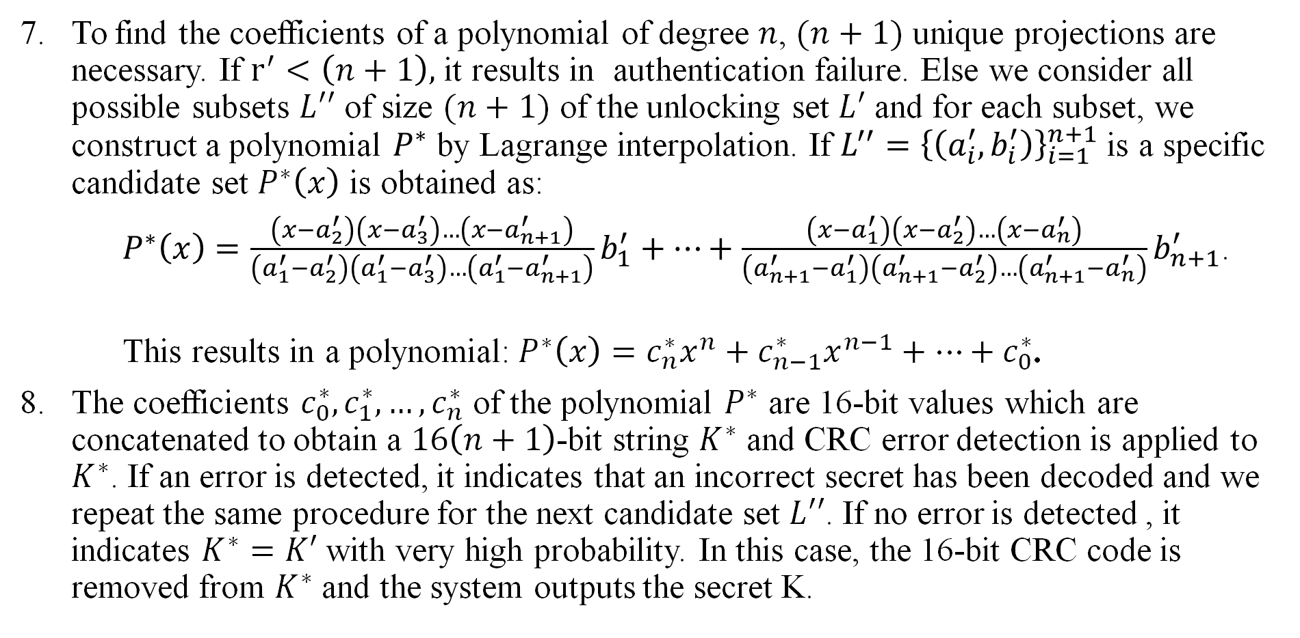
Vault Decoding
To find the coefficients of a polynomial of degree $n$, $(n+1)$ unique projections are necessary. If $r^{′}<\left(n+1\right),$ it results in authentication failure. Else we consider all possible subsets $L′′$ of size $(n+1)$ of the unlocking set $L′$ and for each subset, we construct a polynomial $P^{∗}$ by Lagrange interpolation. If $L^{′′}={\left\{\left(a_{i}^{′},b_{i}^{′}\right)\right\}}_{i=1}^{n+1}$ is a specific candidate set $P^{∗}\left(x\right)$ is obtained as:
$P^{∗}\left(x\right)=\frac{\left(x−a_{2}^{′}\right)\left(x−a_{3}^{′}\right)…\left(x−a_{n+1}^{′}\right)}{\left(a_{1}^{′}−a_{2}^{′}\right)\left(a_{1}^{′}−a_{3}^{′}\right)…\left(a_{1}^{′}−a_{n+1}^{′}\right)}b_{1}^{′}+…+\frac{\left(x−a_{1}^{′}\right)\left(x−a_{2}^{′}\right)…\left(x−a_{n}^{′}\right)}{\left(a_{n+1}^{′}−a_{1}^{′}\right)\left(a_{n+1}^{′}−a_{2}^{′}\right)…\left(a_{n+1}^{′}−a_{n}^{′}\right)}b_{n+1}^{′}$.
This results in a polynomial:$P^{∗}\left(x\right)=c_{n}^{∗}x^{n}+c_{n−1}^{∗}x^{n−1}+…+c_{0}^{∗}$.
The coefficients $c_{0}^{∗},c_{1}^{∗},…,c_{n}^{∗}$ of the polynomial $P^{∗}$ are 16-bit values which are concatenated to obtain a $16\left(n+1\right)$-bit string $K^{∗}$ and CRC error detection is applied to $K^{∗}$. If an error is detected, it indicates that an incorrect secret has been decoded and we repeat the same procedure for the next candidate set $L′′$. If no error is detected , it indicates $K^{∗}=K′$ with very high probability. In this case, the 16-bit CRC code is removed from $K^{∗}$ and the system outputs the secret K.

Slide 22
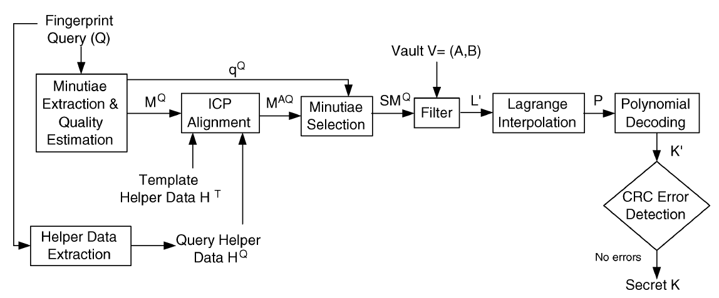
Decoding Process

Slide 23
Fingerprint Alignment based on Helper Data
Alignment of fingerprint images is necessary in fingerprint authentication systems, but it is more challenging in biometric cryptosystems like the fuzzy vault.
This is because the original fingerprint template is not available during authentication and only a transformed version of the template is available in the fuzzy vault.
Previous approaches used a reference point for alignment, which can lead to errors or false rejects.
A new approach uses helper data extracted from the fingerprint orientation field to assist in alignment without compromising security.
The helper data are stored as public information, carry sufficient information for accurate alignment, and do not reveal any information about the minutiae attributes or affect the security of fuzzy vault.
High curvature points are extracted from the fingerprint orientation field, which acts as helper data

Slide 24
Helper Data Extraction
An orientation field flow curve is used to extract data from a fingerprint image for accurate alignment in a biometric cryptosystem.
Flow curves are similar to fingerprint ridges but are not affected by breaks and discontinuities.
Four steps are used to extract the helper data, including
1) estimating the orientation field
2) extracting flow curves
3) determining maximum curvature points
4) clustering high curvature points
High curvature points tend to occur near singular points in the fingerprint image and can be clustered using a single-link clustering algorithm.
Reference : S. C. Dass and A. K. Jain, “Fingerprint classification using orientation field flow curves,” in Proc. Indian Conf. Computer Vision, Graphics and Image Processing, Kolkata, India, Dec. 2004, pp. 650–655.

Slide 25
Algorithm for Helper Data Extraction

Slide 26
ICP Algorithm
The trimmed Iterative Closet Algorithm (ICP) is used to align and estimate the rigid transformation between two fingerprint images T and Q using helper data sets obtained from them.
It is used to overcome alignment errors due to partial overlap between the two sets.
The query minutiae set is aligned with the template based on the rigid transformation output by the ICP algorithm.
If there are multiple clusters in the helper data sets, the ICP algorithm is repeated for all possible cluster pairs to select the aligned query minutiae set with the largest unlocking set.
Reference: P.Besl and N.McKay, “A method for registration of 3-D shapes,” IEEE Trans. Pattern Anal. Mach. Intell., vol. 14, no. 2, pp. 239–256, Feb. 1992.

Slide 27
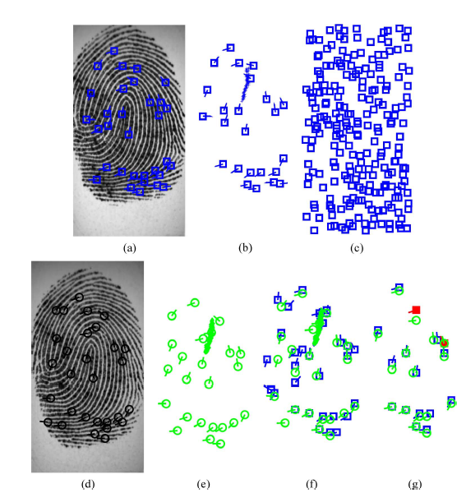
Notes:
Example of successful operation of the fuzzy vault.
Template fingerprint image with minutiae.
Selected template minutiae and helper data.
Vault in which the selected template minutiae are hidden among chaff points (for clarity, minutiae directions are not shown).
Query fingerprint image with minutiae.
(e) Selected query minutiae and helper data.
(f) ICP alignment of template and query helper data sets and coarse filtering of chaff points. (g) Unlocking set obtained by applying a minutiae matcher which eliminates almost all of the chaff points. The two points shown in filled squares in (g) are the only chaff points that remain
in the unlocking set.
Here, figures (a)–(c) represent vault encoding and (d)–(g) represent decoding.

Slide 28
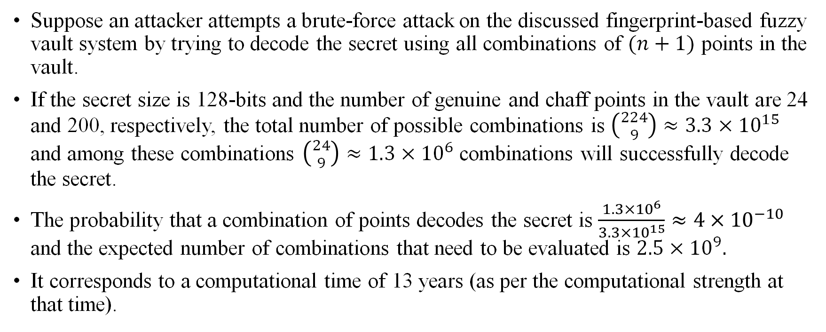
Security of discussed Fuzzy Vault
Suppose an attacker attempts a brute-force attack on the discussed fingerprint-based fuzzy vault system by trying to decode the secret using all combinations of $(n+1)$ points in the vault.
If the secret size is 128-bits and the number of genuine and chaff points in the vault are 24 and 200, respectively, the total number of possible combinations is $\left({224 \atop 9}\right)≈3.3×{10}^{15}$ and among these combinations $\left({24 \atop 9}\right)≈1.3×{10}^{6}$combinations will successfully decode the secret.
The probability that a combination of points decodes the secret is $\frac{1.3×{10}^{6}}{3.3×{10}^{15}}≈4×{10}^{−10}$ and the expected number of combinations that need to be evaluated is $2.5×{10}^{9}.$
It corresponds to a computational time of 13 years (as per the computational strength at that time).
Notes:
The second method of circumvention involves the extraction of information from the helper data. We have already pointed out that high curvature points do not reveal any information about the minutiae and it is not possible to estimate the orientation field using only the high curvature points. However, suppose a smart attacker is able to extract the orientation field from the helper data and uses it to identify the chaff points. We can still defend against such an attack by adding a sufficient number of chaff points that are consistent with the orientation field (i.e., the location of the chaff minutia is random, but its direction is
determined by the orientation field) in addition to the completely random chaff points.

Slide 29
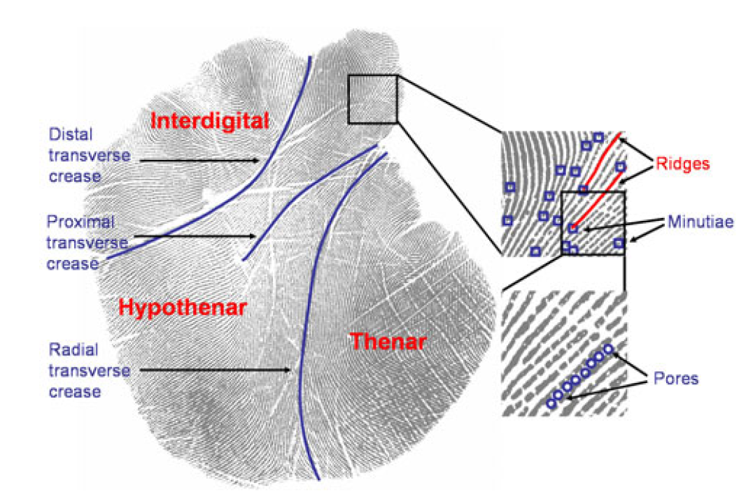
Biometric Template Security Using Palm Print Features
Palm print is a combination of mainly two features, the palmar friction ridges and the palmar flexion creases.
The corrugated skin patterns with sweat glands are known as palmar friction ridges.

Slide 30
Discontinuities in the epidermal ridge patterns are called the palmar flexion creases.
There are three palmprint regions:
Interdigital
Thenar
Hypothenar
Multimodal fuzzy vault for template security can also be used for protecting the biometric template.
Multimodal biometric technology uses more than one biometric identifier to compare the identity of a person.
This uses a combination of different biometric recognition technologies.
Their performance is well compared to single modal biometric systems.
The multimodal biometric fuzzy vault includes combined feature points from fingerprint and palm print to enhance the security of the template stored.

Slide 31
Steps involved in Vault Encoding of Palmprint
Binarization: Ridges in palm print are highlighted with black colour while furrows are white. It transforms the 8-bit Gray fingerprint image into a 1-bit image with 0-value for ridges and 1-value for furrows.
Thinning: Ridge thinning is performed to eliminate the redundant pixels of ridges till the ridges are just one pixel wide.
Minutiae Extraction: Here both bifurcation and termination of ridges in the palm prints are taken. Orientation field is generated
Polynomial Evaluation: A polynomial is generated using fuzzy logic method of selecting secret key. Those secret keys are known only to the person who is securely protecting the template.
Addition of Chaff Points
Vault Generation
Notes:
Orientation field is generated which not only shows the angle formed by ridge. It also represents the directionality of ridges in the palm print image. Region Of Interest (ROI) is useful for the recognition of each image. The image area without effective ridges and furrows is first discarded since it only holds background information. It depends on the locations of minutiae and the directions of ridges at the minutiae location. False minutiae are affecting the accuracy of matching. So, removing false minutiae are essential to keep the palm print verification system effective.

Slide 32

Thank You!
Notes:
A well-known limitation of the fuzzy vault framework is its dependence on chaff points to achieve security.
Therefore, fuzzy constructions that do not involve chaff points could be considered.

